Slide 1
Park Locations
Mark Rossitto

Slide 2
Finding a park
When considering a move, many will often consider the environment in the prospective location of interest. For a city setting, this may just come down to the amount of parks or outdoor locations available to them within their general vicinity. With the emerge of Covid-19, finding a safe outdoor location(s) has become a new trend in an effort to escape the monotony of being trapped inside and being forced to work from home. This may factor in to those who are considering a move to a new city, especially while a vaccine is not readily accessible.

Slide 3
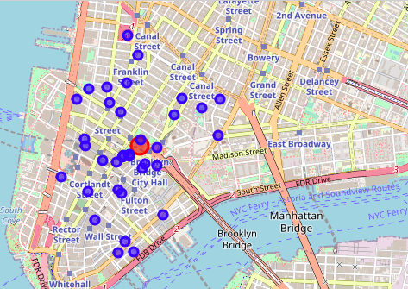
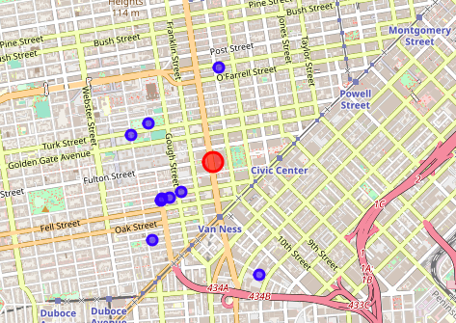
New York and San Francisco Data
To being the comparison process, I began to investigating the two cities of San Francisco to see all the venues categorized as park locations.
To my surprise, I came across the fact that New York had almost 30 locations within my set radius as Opposed to the 8 locations found in San Francisco.
I was able to create the center points used for the mapping through the Geolocator, the park locations using the foursquare API, and was able to create mapping of the two using Follium.

Slide 4
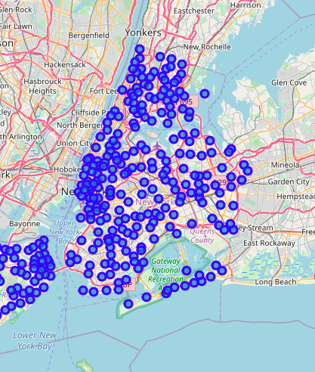
Deep Dive Data Analysis
After the primary results of my project came to be in favor of New York sporting more park categorized, I further evaluated New York as whole and saw the numerous neighborhood locations through the city, offering more than enough living locations and venues as well, as provided by the Foursquare API

Slide 5
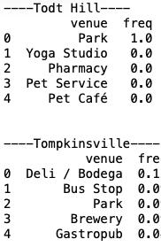
Parks: A common venue
In searching the different types of venues throughout the many neighborhoods of New York, I’ve found parks to be a common and frequent venues in numerous neighborhoods, which supports the city as potentially being a new home to those looking to have many park to visit away from home.

Slide 6
Conclusion
To conclude my findings, I found New York to be a very viable option for those looking for a new setting with a number of parks to chose from. My first part of the project had shown me that New York offers more locations than other cities such as San Francisco within a realistically set radius. To follow up , I’ve concluded that there are numerous neighborhoods and possible living spaces that would allow for a the person more than enough choices in terms of visiting a park as it was a frequent location across many of these New York neighborhoods. Furthermore, I analyzed just how similar these neighborhoods were using clustering and found the majority to fall with in two of the 5 possible clusters. Finding this offers the insight that choice of neighborhood may not make the biggest difference as the majority have a similar make up. In any case, New York seems to be a solid option for those looking to relocate while still being able to get outdoors to a favorable location.

